Slide 1
02 | Windows Azure SQL Database Fundamentals
Chris Auld | CTO – Intergen Limited, Azure MVP
Greg Leake | Director, SQL Server Product Management

Slide 2
Module Overview
SQL Database Architecture
Tooling
Security
Monitoring
Backup

Slide 3
Point 1:
SQL Database Architecture

Slide 4
A Server Is Not A Machine
SQL Server
A Machine
SQL Database Server
A TDS
Proxy Endpoint

Slide 5
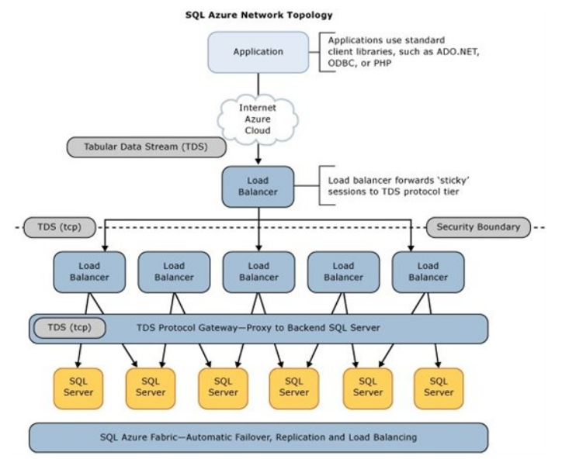
How It Works

Slide 6
How It Works
Client Layer
PHP
SQL Server
Applications
and Tools
WCF Data Services
Architecture
Client Layer - Used by application to communicate directly with SQL Database.
Services Layer – Gateway between Client layer and Platform layer.
Platform Layer – Includes physical servicers and services that support the Services layer.
Infrastructure Layer – IT administration of the physical HW and OS.
ODBC/JDBC
ADO.NET
Tabular Data Stream (TDS)
TDS+SSL
Services Layer
Provisioning
Provisioning
Provisioning
…
Billing and Metering
Billing and Metering
Billing and Metering
…
Connection Routing
Connection Routing
Connection Routing
…
Platform Layer
SQL Server
SQL Server
SQL Server
…
SQL Database Fabric
SQL Database Fabric
SQL Database Fabric
…
Management Services
Management Services
Management Services
…
Infrastructure Layer

Slide 7
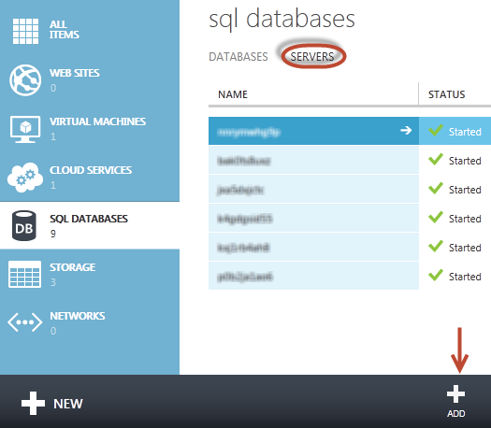
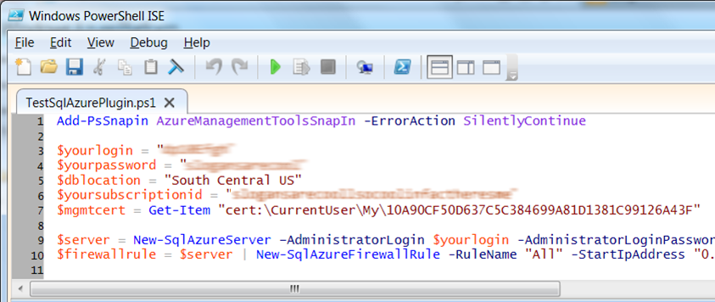
Server Provisioning
Server Defined
Service head that logically groups databases
Connect via automatically generated FQDN (xxx.database.windows.net)
Initially contains only a master database
Provision Servers Interactively
Log on to Windows Azure Management Portal
Create a SQL Database server
Specify admin login credentials
Add firewall rules and enable service access
Automate Server Provisioning
Use Windows Azure Platform PowerShell cmdlets (or use REST API directly)
wappowershell.codeplex.com

Slide 8

SQL Database Firewall
Internet
Securing your data
IP Address-based access control for SQL Database
Rules can be defined at the server and/or database level
No IP authorized by default, not even Azure itself
Configurable using the SQL Database Portal and REST API
Option to disable/enable access from applications hosted in Windows Azure
Services Layer
SQL Database Firewall
Services Layer

Slide 9
Provisioning a Server [Greg] Configuring Firewall Rules Creating a Database Connecting via SSMS

Slide 10
Point 2:
Tooling

Slide 11
Management Tooling
Azure Management Portal
SQL Database Management Portal
SQL Server Management Studio
REST API & PowerShell
3rd Party Tools
Server Configuration
Database Creation
Firewall Configuration
High Level Monitoring
HTML based
Rich browser based IDE
Database design
View stats and query plans
Silverlight based
Object Explorer
Query Windows
Execution Plans
Many features not supported - SQL Agent - Management Plans - etc…
Control deployment
Automate management
Useful for lifecycle management
Continuous build/integration
TDS Compatability
Visual Studio
RedGate
ERWin
DB Artisan
Etc…

Slide 12
Database Management using the SQL Database Management Portal [Chris]

Slide 13
Point 3:
Security

Slide 14
Server Level Security
Pre defined server level users and roles
SQL authentication supported (No Integrated authentication)
The Admin login is similar to sa
Connect to master to administer logins
loginmanager: Server-Level security role for creating logins
dbmanager: Server-Level security role for creating databases

Slide 15
Database Level Security
Database identity and access control per on premises SQL Server Authentication
Logins require an associated user account
The Admin login is automatically associated with dbo
The dbo has full rights in the database
Manage users with CREATE / ALTER / DROP USER commands
Add users to roles via sp_add_rolemember to grant privileges
Utilize schemas where appropriate

Slide 16
Application Connectivity
Connecting To SQL Database
TDS (Tabular Data Stream) protocol over TCP/IP supported
SSL required
Use firewall rules to connect from outside Microsoft data center
ASP.NET EXAMPLE:
Mini Demo: Connection Strings in Portal
Deep dive on developer topics in later modules.
<connectionStrings>
<addname="AdventureWorks"connectionString=
"Data Source=[server].database.windows.net;
Integrated Security=False;
Initial Catalog=ProductsDb;
User Id=[login]@[server];
Password=[password];
Trusted_Connection=False;
Encrypt=true;"
providerName="System.Data.SqlClient"/>
</connectionStrings>

Slide 17
Creating Logins and Database Users [Chris]

Slide 18
Point 4:
Monitoring

Slide 19
Database Monitoring
Large Range of Monitoring Options
Query Plans
Extended Events
DMVs
Event Table
There is no SQL Profiler – Use DMVs

Slide 20
Using DMVs [Chris]

Slide 21
Point 5:
Backup

Slide 22
Backup
Why We Backup
Loss of the datacenter/drives/hardware
Application errors
Stupid mistakes while logged in as SA
Backup Options
Currently no standard point-in-time backup
Use CREATE DATABASE … AS COPY OF
Export copy as BACPAC to Azure Blob Storage

Slide 23
Using CREATE DATABASE … AS COPY OF [Chris]

